Slide 1

Hotel Booking
Understanding the factors influencing hotel cancellations is crucial for optimizing revenue management strategies. This presentation explores key variables affecting cancellations and offers data-driven insights to assist hotels in making informed pricing and promotional decisions.
By Amit Ghosh

Slide 2
Hotel Booking
Analysis question:
What are the variables that affect hotel reservation cancellations?
How can we make hotel reservation cancellations better?
How will hotels be assisted in making pricing and promotional decisions?
Hypothesis:
More cancellations occur when prices are higher.
When there is a longer waiting list, customers tend to cancel more frequently.
The majority of clients are coming from offline travel agents to make their reservations.

Slide 3
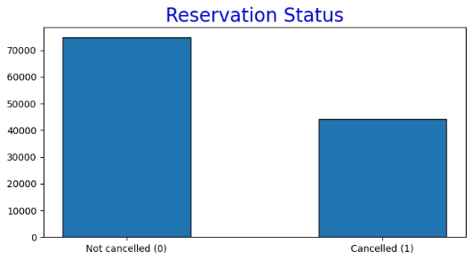
Cancellation Trends: A Closer Look
The accompanying bar graph shows the percentage of reservation that are canceled and those that are not. It is obvious that there are still a significant number of reservations that have not been canceled. There are still 37% of client who canceled their reservation, Which has a significant impact on the hotels’ earnings. In comparison to resort hotels, city hotels have more bookings. It’s possible that resort hotels are more expensive than those in cities.
Despite a large percentage of confirmed reservations, 37% of bookings are canceled. This significantly impacts hotel earnings. City hotels generally have more bookings than resort hotels, possibly due to pricing differences.

Slide 4
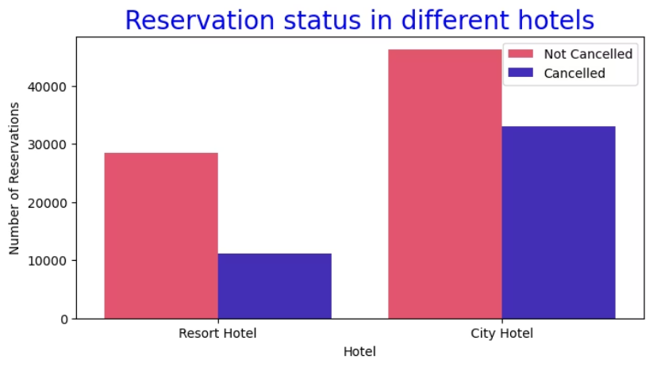
Hotel Type Booking Distribution
In comparison to resort hotels, city hotels have more bookings. It’s possible that resort hotels are more expensive than those in cities.
City Hotels
More bookings
Resort Hotels
Fewer bookings
City hotels exhibit higher booking volumes. This may be attributed to potentially higher prices at resort hotels. Location and amenities also play a role in booking preferences.

Slide 5
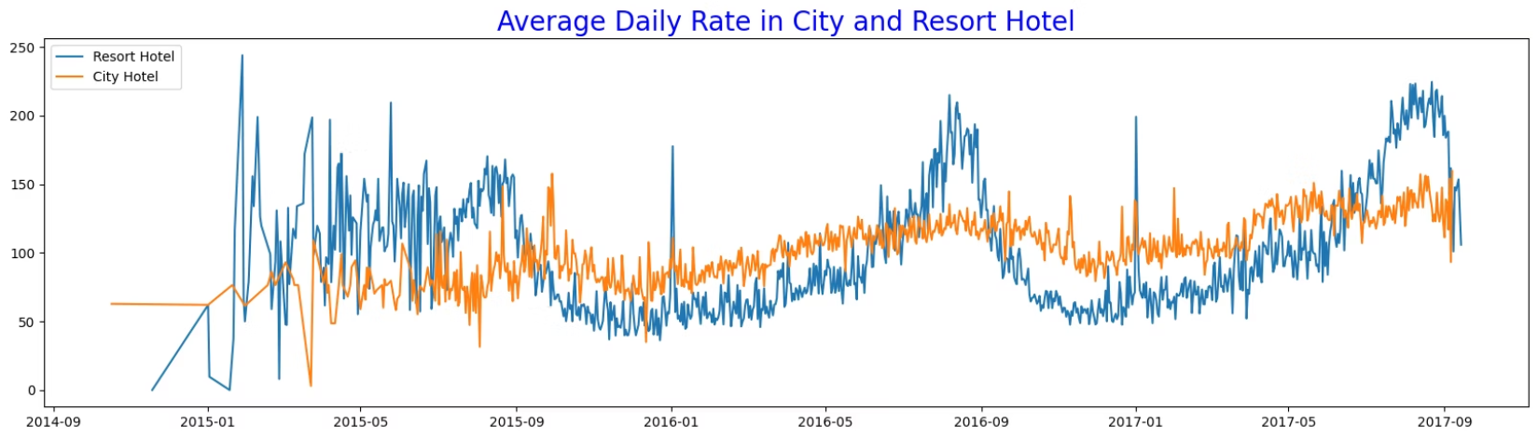
Average Daily Rate Comparison
City Hotel ADR
Resort Hotel ADR
Often lower than resort hotels. Rates can fluctuate daily.
Generally higher, especially on weekends and holidays. Demand influences pricing.
City hotel average daily rates are frequently lower than resort hotels. Resort rates typically increase during peak times like weekends and holidays. This pricing dynamic directly impacts booking patterns.

Slide 6
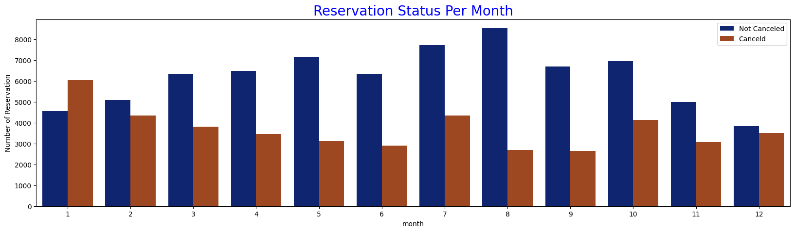
Monthly Reservation
Trends
1
January
Highest cancellations. Low confirmed bookings.
2
August
Peak for both confirmed and canceled reservations. High demand.
3
Other Months
Varying booking and cancellation rates. Seasonal impacts.
August sees the highest volume of both confirmed and canceled reservations. Conversely, January experiences the most cancellations. This indicates seasonal patterns in booking behavior.

Slide 7




Price Elasticity of Cancellations
High Prices
Lead to more cancellations.
Low Prices
Result in fewer cancellations.
Direct Correlation
Accommodation cost drives cancellations.
Data confirms a strong correlation: higher prices lead to more cancellations. The cost of accommodation is the primary driver for reservation cancellations, highlighting price sensitivity.

Slide 8
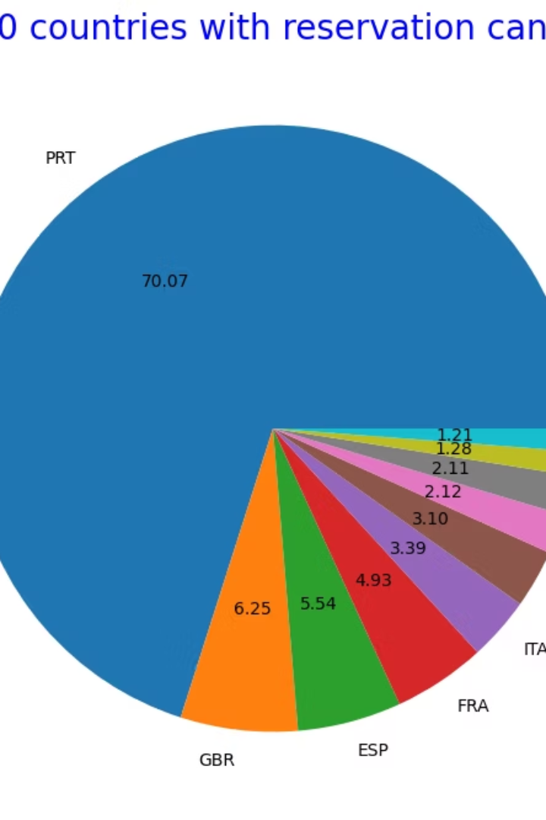



Customer Waitlist Impact
Longer Waitlists
Increased likelihood of cancellations.
Customer Patience
Diminishes with extended waits.
Booking Flexibility
Guests seek immediate confirmation.
A prolonged waiting list contributes to higher cancellation rates. Guests prefer immediate confirmation, and delays can prompt them to seek alternative accommodations. This dynamic emphasizes the need for efficient booking processes.

Slide 9
Geographic & Channel Breakdown
Cancellations by Country
Booking Channels
Portugal has the highest number of cancellations. This suggests a regional influence on booking behavior.
Online Travel Agents: 46%
Groups: 27%
Direct Bookings: 4%
Portugal accounts for the highest cancellations. Online travel agencies drive nearly half of all bookings. Direct bookings represent a small fraction, indicating reliance on third-party channels.

Slide 10
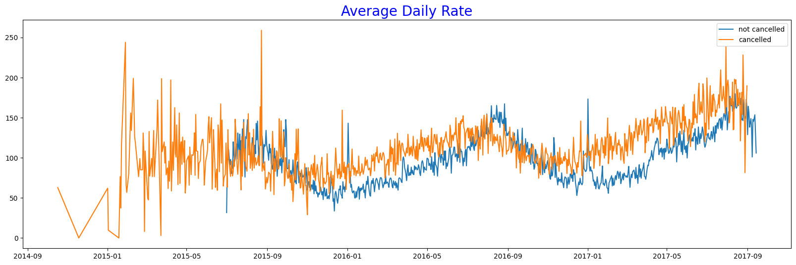

Slide 11
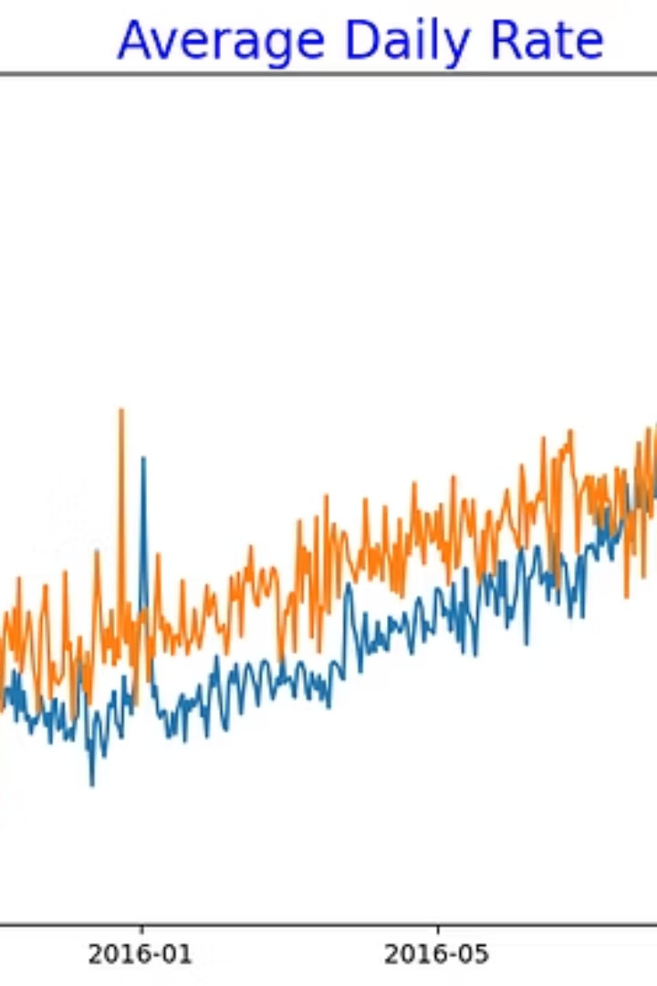
Price-Cancellation Relationship Confirmed
Higher
Lower
Clear
ADR
ADR
Evidence
Correlates with more cancellations.
Results in fewer cancellations.
Price directly impacts cancellation rates.
The graph explicitly shows that higher average daily rates lead to more cancellations. This reinforces our earlier analysis, emphasizing price as a critical factor in customer decisions.

Slide 12

Recommendations for Revenue Optimization
Dynamic Pricing
Resort Hotel Strategy
Adjust rates based on demand. Offer targeted discounts for specific hotels or locations. Consider off-peak promotions.
Implement reasonable discounts on weekends and holidays. Improve the value proposition for longer stays.
January Marketing
Service Enhancement
Launch targeted marketing campaigns. Increase promotional efforts to boost bookings during low periods. Offer special January packages.
Focus on improving hotel quality in Portugal. Enhance guest services to reduce cancellations. Prioritize guest satisfaction.
Implement dynamic pricing to counter cancellations. Offer discounts for resort hotels during peak times. Strategically market in January, and enhance service quality, especially in Portugal.

